Slide 1
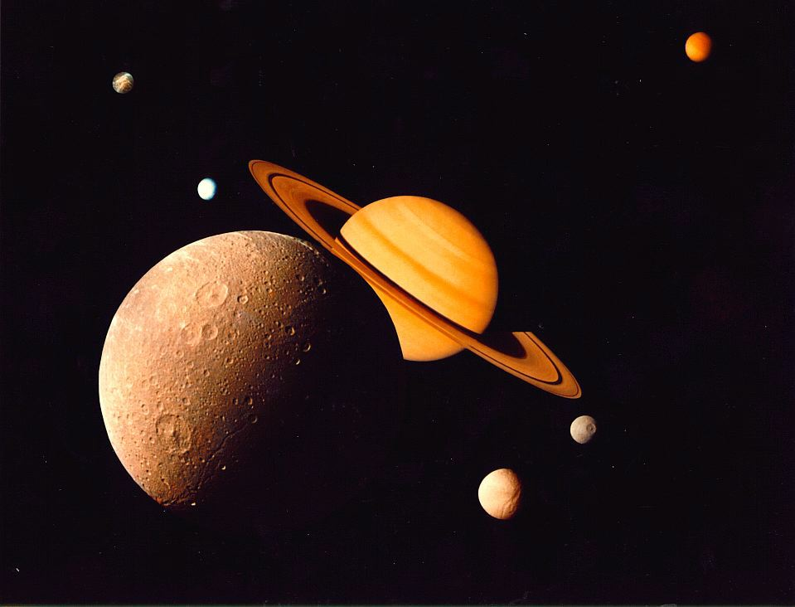
Sizing Up Saturn

Slide 2
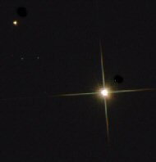
Iota Draconis
Through the Telescope
Iota Draconis is a star with almost the same mass as our Sun located about 100 light years away from Earth.

Slide 3
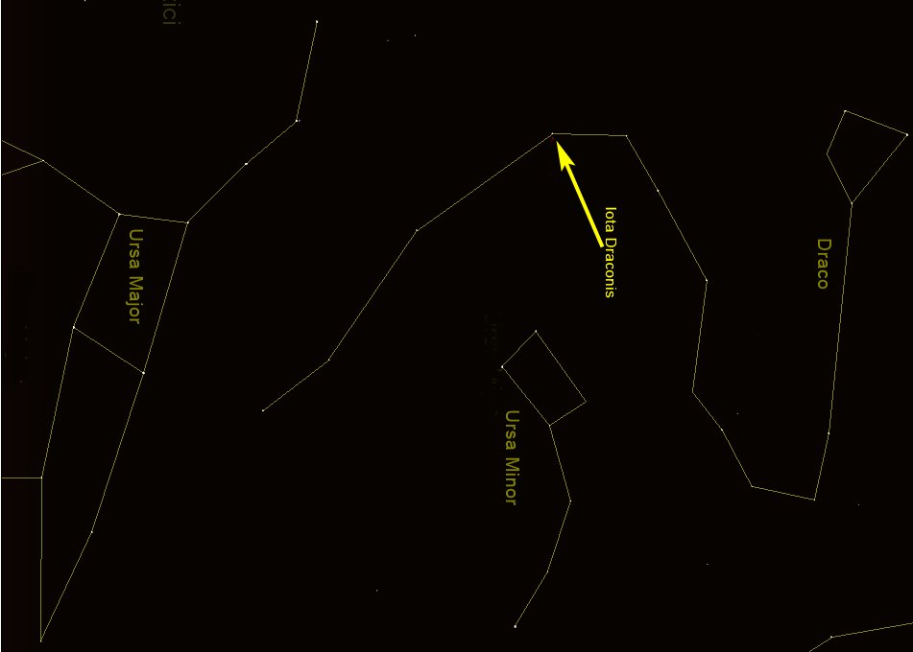
Iota Draconis
In the Night Sky
North Star
Iota Draconis can be found in the constellation Draco the dragon, about half way down the dragon’s body.

Slide 4
Iota Draconis Facts
Iota Draconis has a surface temperature of about 8,400°F … a bit cooler than our Sun’s 10,000°F surface temperature.
Iota Draconis
Sun
It has almost the same mass as our Sun, but its diameter is 11 to 13 times greater.

Slide 5
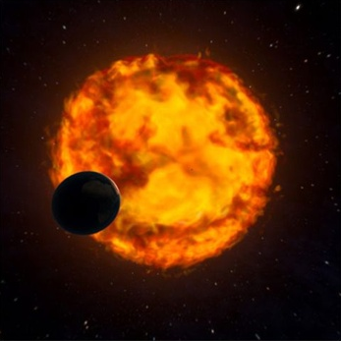
Iota Draconis Facts
It was the first giant star found having a planet orbiting it – This could give us a sneek “peek” at our solar system’s eventual fate.

Slide 6
Iota Draconis b
In 2002, astronomers working at the Lick Observatory discovered an extrasolar planet orbiting Iota Darconis. It was designated “b”
b

Slide 7
Iota Draconis b
It has 8.6 times more mass than Jupiter but it’s almost the same diameter yet it is still considered a Jovian or gas-giant type planet.
b

Slide 8
Iota Draconis b
Mars
Earth
Venus
Mercury
Iota Draconis
b
The planet has a very elliptical orbit. If you put it in our solar system, it would come closer to the Sun than Mercury and it would go farther out than Mars.

Slide 9
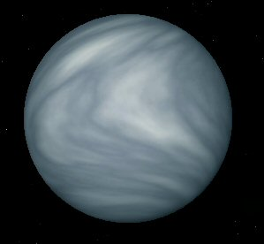
Iota Draconis b
Artist’s concept
Iota Draconis b takes 511 days to orbit its star. When it is closest to its star, it surface temperature is over 1,100°F but when it’s farthest away, it’s “only” 375°F. Needless to say, it is NOT a habitable planet.

Slide 10
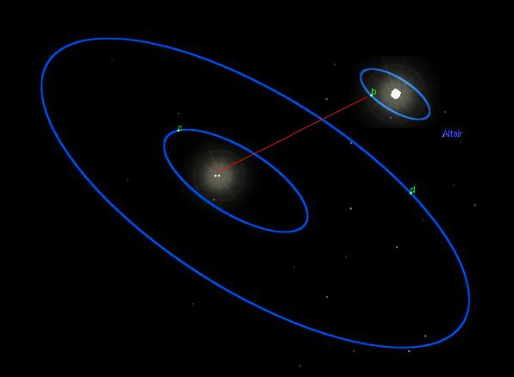
Extra-solar Planets
Extra-solar planets are planets that orbit stars other than our Sun
They form solar systems of their own

Slide 11
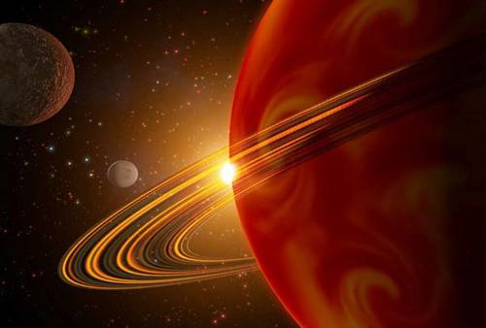
Extra-Solar Planets
Astronomers began finding planets around other stars in 1995 and have, so far, found over 750.
Most of the extra-solar planets discovered so far are large, the mass of Neptune or larger.

Slide 12
Finding Extra-Solar Planets
Almost all extra-solar planets are much too far away and too small to see. However, astronomers have several indirect methods of detecting their presence.
Radial velocity
Transit
Astrometry
Direct imaging
Micro-lensing
Pulsar timing

Slide 13
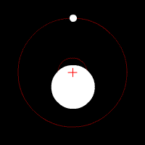
Finding Extra-Solar Planets
Doppler Spectroscopy & Radial Velocity
The vast majority of extra-solar planets have, so far, been detected using Doppler spectroscopy.

Slide 14
Finding Extra-Solar Planets
Doppler Spectroscopy & Radial Velocity
As a planet orbits its star, its gravitational pull causes the star to wobble back and forth slightly.

Slide 15
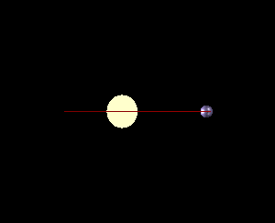
Finding Extra-Solar Planets
Doppler Spectroscopy & Radial Velocity
If the orbital plane of the planet is close to our line-of-sight, we can measure slight changes in the star’s spectrum due to the Doppler shift as the planet pulls the star first toward us and then away from us.

Slide 16
Finding Extra-Solar Planets
Astrometry
When a star system is oriented like this, we can detect the influence of an unseen planet orbiting it by precisely measuring the star’s position in the sky and observing how it changes (wobbles) over time.

Slide 17
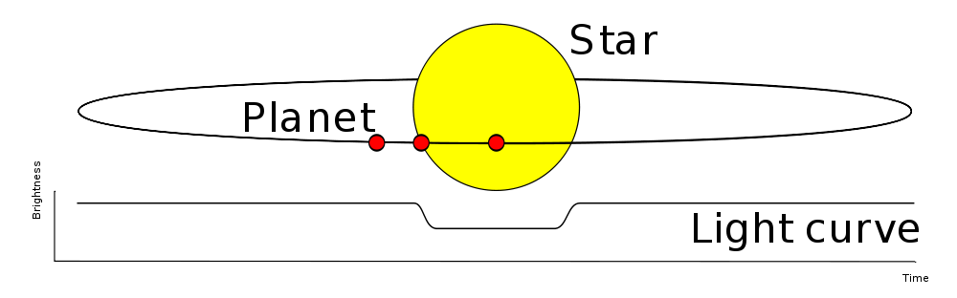
Finding Extra-Solar Planets
Transit Method
If the orbital plane of an extrasolar planet is along our line-of-sight, we can measure the slight dip in the amount of light the star emits as the planet passes in front of it. This is the transit method.

Slide 18
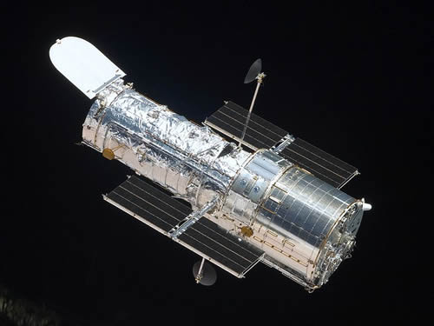
Finding Extra-Solar Planets
Direct Imaging
Very few extra-solar planets have been directly imaged.
Extra-solar planets are VERY far away and relatively small.
They reflect only a very small amount of the light from their parent star and that gets overpowered by the star’s light.

Slide 19
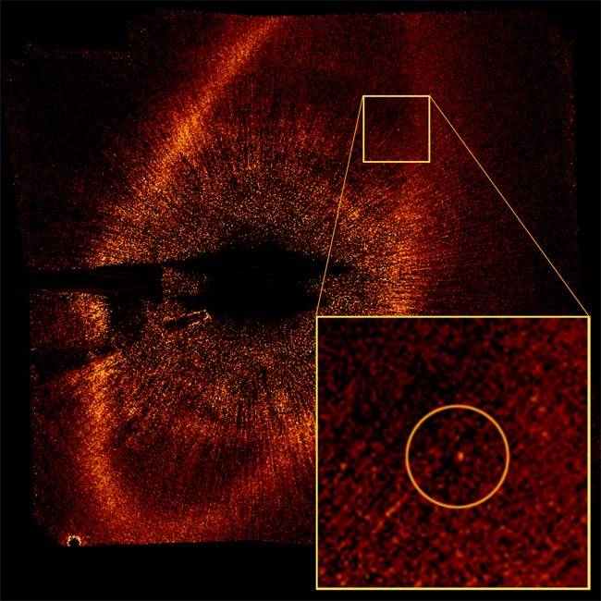
Finding Extra-Solar Planets
Direct Imaging
However, in recent years,
the Hubble Space Telescope
and a few ground-based telescopes have had some limited success in directly imaging extra-solar planets orbiting stars in our galactic neighborhood.
Hubble Image of Fomalhaut b

Slide 20
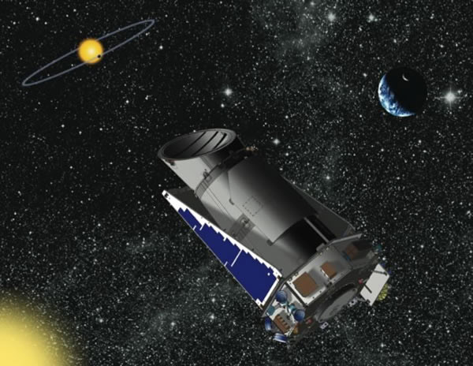
Finding Extra-Solar Planets
Kepler Mission
The Kepler mission was launched in March 2009.
It’s mission is to look specifically for Earth-like planets orbiting other stars.
It is constantly staring at 156,000 stars in a small area of the sky in the Cygnus, Lyra and Draco constellations.

Slide 21
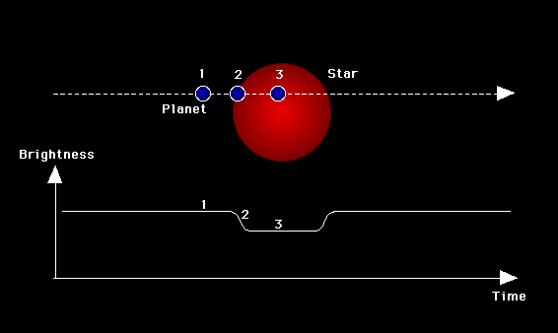
Finding Extra-Solar Planets
Kepler Mission
Kepler uses the transit method of detecting planets.
It measures the slight dimming of light caused by a planet passing in front of its parent star.

Slide 22
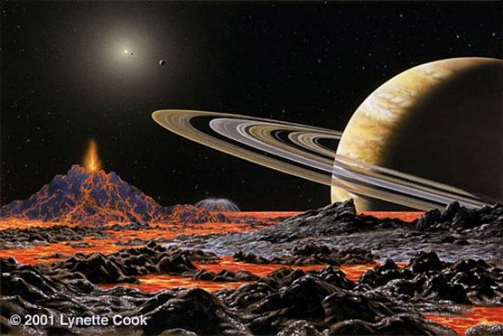
Finding Extra-Solar Planets
Kepler Mission
As of February, 2012, Kepler had found 2,321 planetary candidates and hundreds of those have been confirmed by ground-based observations.
Artist’s Concept

Slide 23

Finding Extra-Solar Planets
Kepler Mission
Of the 2,321 planetary candidates found so far, 48 of them are in their star’s habitable zone.
Artist’s concept

